Slide 1
Toxic Comment Classification
Helping online platforms identify toxicity, one comment at a time
Team Blue:
Amrita Ligga
Rizabek Zhumkenov
Scott Wais
Sudhanshu Rai
Sumeet Duddagi

Slide 2
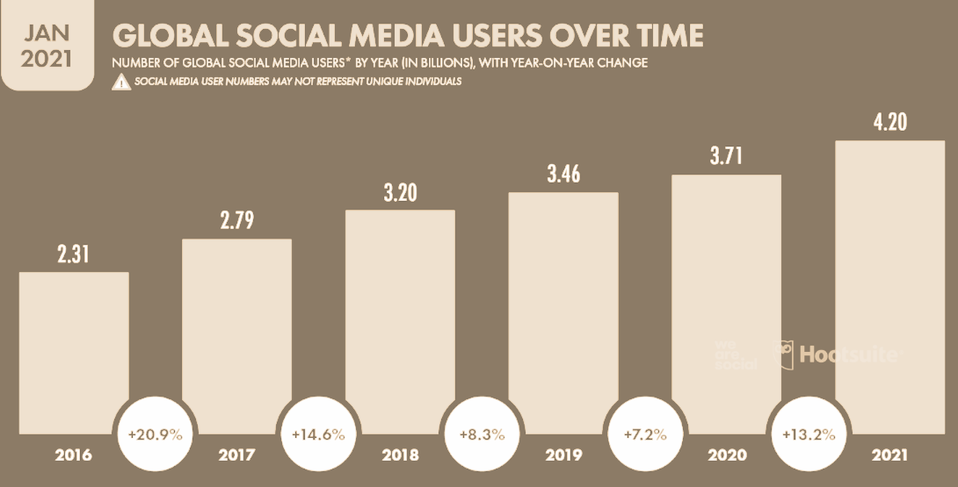
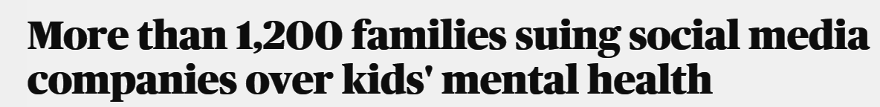
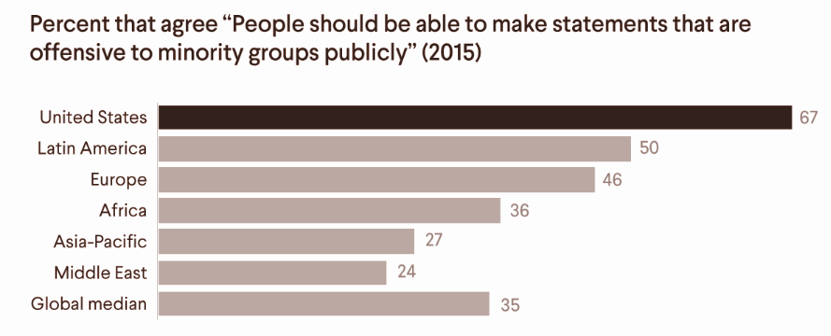


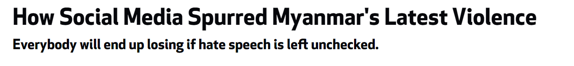
Toxicity - a widespread problem
Toxic content growth
Effect on Online Platforms
Notes:
Social media users have been increasing rapidly, with an average annual growth rate of about 10% in the last two years. As of 2021, there are 4.2 billion users.
As the number of users increase the production and consumption of the content created by them also increases. Along with this comes content moderation challenges.
According to a study done in 2015, about 67% of people in the US agreed that “People should be able to make statements that are offensive to minority groups publicly”. This implies that more than half the population would prefer free speech over moderated content. This brings in new challenges for everyone in the society where social media can be used to disrupt peace and cause political tensions. Even more so is the impact on online platforms that face huge liabilities if unchecked toxic content on their website causes catastrophic events. They are burdened with lawsuits, bad image connotations and consequent reduction in revenues.
https://www.cfr.org/backgrounder/hate-speech-social-media-global-comparisons#chapter-title-0-4

Slide 3
Problem Statement
The internet is a place where people can post their views easily, resulting in challenges for online platforms to regulate what is being posted. These platforms might struggle to prevent online abuse or harassment of different communities. Not handling toxic comments can cause several problems for the platforms:
Lawsuits
Damage to reputation
Reduced traffic
Reduced Ad revenue
Using this dataset and text analytics techniques, we aim to build a model to identify toxic comments for such online platforms.
Notes:
Literature backing reduced ad revenue: https://www.cnn.com/2022/11/04/tech/twitter-advertisers/index.html: “Most marketers bristle at the thought of having their ads run alongside toxic content such as hate speech, pornography or misinformation.. Ad buying giant Interpublic Group, which works with consumer brands such as Unilever and Coca Cola, earlier this week also recommended its clients pause advertising on the platform”

Slide 4
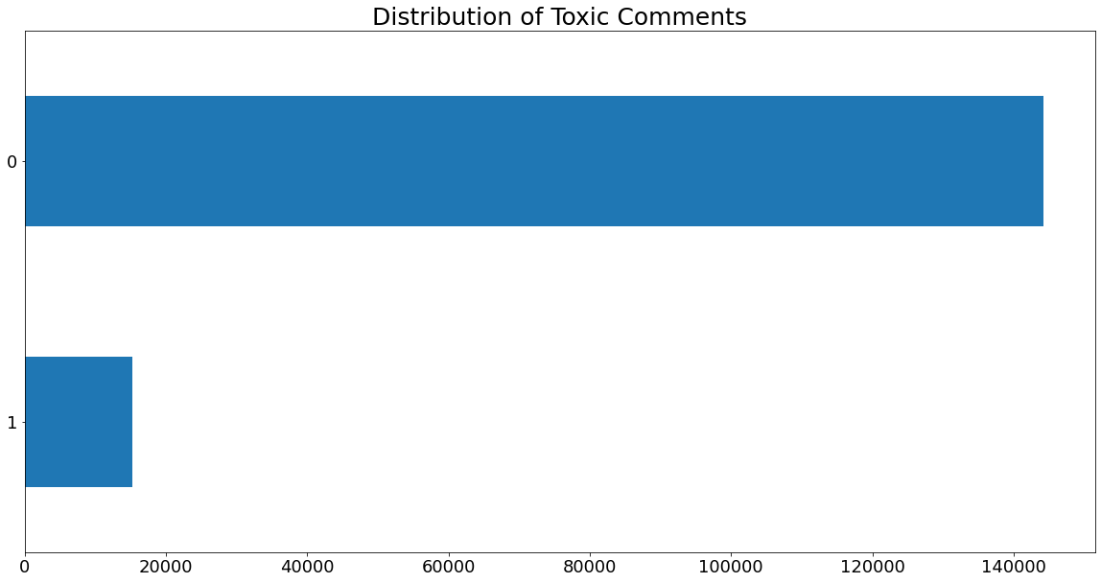
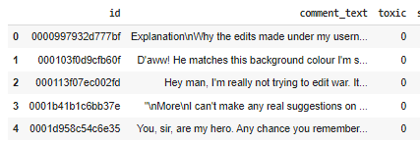
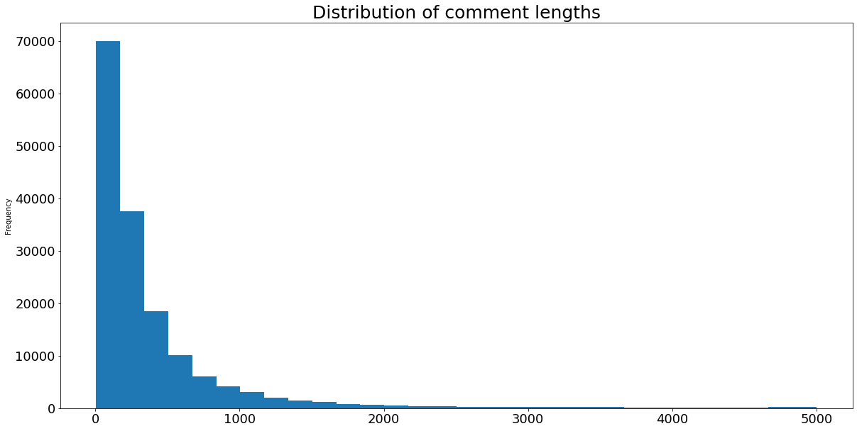
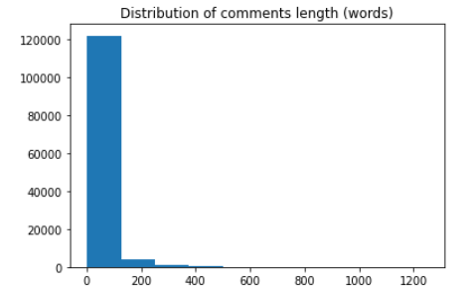
Data
159,571 Wikipedia comments
3 Columns: id, comment_text, toxic label
Toxic comments: ~10%
Comment Length Distribution: Right skewed with most comments between 0-500 characters or 0-100 words long

Slide 5
Cleaning and Data Preparation
Average Count Caps Column
Word Replacements
Word Removals
Final Preparation
Non English Words
Special characters like ~, *, +, =
Sentence punctuations
HTML characters like \n
Stopwords
Many toxic comments use capital letters to emphasize strong emotions
This column calculates the following:
[total capital letters/total letters]
This was done before any pre-processing
Word contractions: "mustn't" -> "must not"
Regex Groupings using Textacy [URLs, emails, currency, emojis]
Custom Regex Groupings [IP Addresses, Dates, Child]
Spelling corrections using probability theory
Tokenization
Lemmatization and stemming
Train test split (80:20)
Notes:
Spelling corrections using TextBlob.correct()

Slide 6
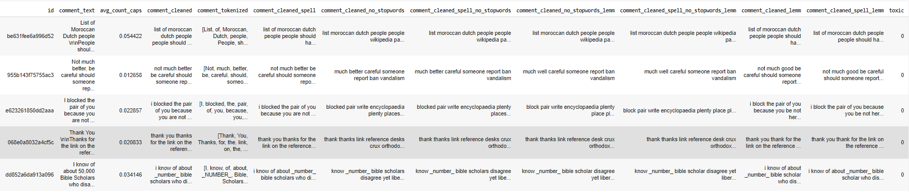
Data Cleaning Samples
Original | Cleaned(with stopwords)
You are wrong about everything \n\nbut for too stupid to notice. You are a lost cause. Your existence is a blemish.137.205.183.70 | you are wrong about everything but for too stupid to notice you are a lost cause your existence is a blemish _ipaddress_
27 January 2010 (UTC)\n\nI have filed a complaint against Cshay for edit warring.\n 22:18 | _datetime_ utc i have filed a complaint against cshay for edit warring _time_
I only comunicate you. I can discute the article because it´s judging by Wikipedia moderators. | i only communicate you i can dispute the article because it s judging by wikipedia moderators
Created different versions of cleaned columns for example with and without stopword removal since some algorithms could work better with stopwords included:
Notes:
The spelling corrections done are not 100% correct. Some internet jargons also got converted
Also since it was taking so long to run the spelling check, only corrected like 2000-3000 words
So spelling corrections might not be done everywhere

Slide 7
Countvectorizer
Countvectorizer
(1,1)
(2,2)
(3,3)
Logistic regression
Random forest
Logistic regression
Random forest
Logistic regression
Random forest
We used lemmatized comments with no stop words for countvectorization. We used the above model combinations to test on testing set using auc roc score, recall, and precision.
The dataset was initially undersampled with 10,000 toxic and 10,000 non-toxic entries, and this was utilized as a training set and evaluated on test set.
Next, the complete dataset was utilized as a training set and tested on test set.
Finally, undersampled dataset performed comparatively better through logistic regression model trigrams with recall of 97.91%, precision of 10.21%, auc_roc score of 0.53 and f1 score of 0.18

Slide 8
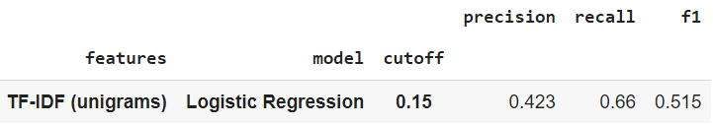
TF-IDF Vectorizer
Vectorized comments with unigrams, bigrams, and trigrams
Used comments that had been cleaned, spell checked, and lemmatized (stopwords removed)
Concatenated vectorized comments with avg_count_caps feature
For each feature set, built three Logistic Regressions and Random Forests
Experimented with different probability cutoffs around the true toxic proportion [0.05,0.1,0.15]
Evaluated performance using precision, recall, and f1-score
Best performance:
ROC AUC for this model: 0.891

Slide 9
Logistic regression (Word2Vec)
Vectorized comments using average word2vec embedding
Used comments that had been cleaned, spell checked, and lemmatized (stopwords removed)
Built a Logistic Regression model for the feature set
Put probability cutoffs 0.5
Evaluated performance using precision, recall, and f1-score
Best performance:
Roc_auc_score: 0.95
Recall: 0.56
Precision: 0.82
F1_score: 0.66
Notes:
roc_auc_score: 0.95
Recall: 0.56
Precision: 0.82
F1_score: 0.66

Slide 10
Deep learning model using pre-trained word embedding
Input data
Embeddings
Document embeddings
Flatten and Dense
Testing result
Training data set contains 127,656 words (lemmatized). We set the padding length 200 based on histogram below.
Input matrix size is
127,656x200
We used glova embedding that has size 100.
Vocab size of training set is 138,467.
Embedding matrix is
138,467 x 100 x 200
We defined that 138,467 x 100 parameters as non-trainable.
Flatten layer has 20,000 parameters (200 x 100).
Dense = 1
Total 20,001 trainable parameters.
roc_auc_score: 0.87
Recall: 0.52
Precision: 0.67
F1_score: 0.52

Slide 11
Deep Learning (RNN and LSTM)
RNN | LSTM
Number of Tokens: 10,000 Max Sequence Length: 200 Glove Embeddings (size:100) Total Parameters: 18,582,417 Number of Trained Parameters: 11,617 | Number of Tokens: 10,000 Max Sequence Length: 200 Glove Embeddings (size:100) Total Parameters: 18,588,369 Number of Trained Parameters: 17,569
Summary: The deep learning models did not perform well giving low precision of ~10%, due to data imbalance.

Slide 12
All Models
Model | ROC-AUC | Precision | Recall | F1-Score
Logistic Regression (Word2Vec embeddings) | 0.95 | 0.82 | 0.56 | 0.58
DL pre-trained embedding glova | 0.87 | 0.67 | 0.52 | 0.52
Logistic Regression (CountVectorizer) | 0.53 | 0.10 | 0.97 | 0.18
Logistic Regression (TF-IDF) | 0.89 | 0.42 | 0.66 | 0.52
RNN | 0.5 | 0.0956 | 1.00 | 0.174
LSTM | 0.5 | 0.0958 | 1.00 | 0.175

Slide 13
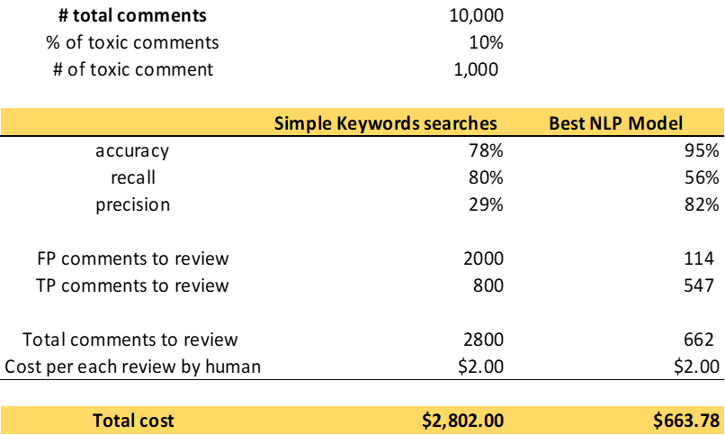
The NLP model could reduce the content moderation cost by 76%
Comments
Simple keyword search is an ineffective method of identifying toxic comments. This method has high recall but leads to high rates of false positives.
The table compares cost of human moderation for 10,000 comments.
Notes:
https://www.eecg.utoronto.ca/~jayar/ece324/2020/download/toxiccommentclassifier.pdf

Slide 14
Limitations, Risk and Assumptions
The case assumes that the company uses simple keyword search to moderate comments. We didn’t compare our model with existing solutions on the market
Although the best NLP model reduces the number of comments to be reviewed by humans, the number of false negative comments will increase
These false negatives carry a hidden cost because they could lead to bad user experiences on our platform. We are assuming that our increase in precision will outweigh this decrease in recall
Even though our dataset was smaller than a real-world dataset, some of our models required a relatively longer time to run and we were limited by less processing power

Slide 15
Conclusion
Toxicity is a major problem on online platforms and advanced NLP techniques can be used to reduce it with lesser human intervention
After preprocessing, we tried various models from simple to complex to identify toxic comments
The best model is Logistic Regression with Average Word2Vec embeddings, providing an F1 score of 0.58 and AUC of 0.95
The approximate ROI is a 76% reduction in moderation cost

Slide 16
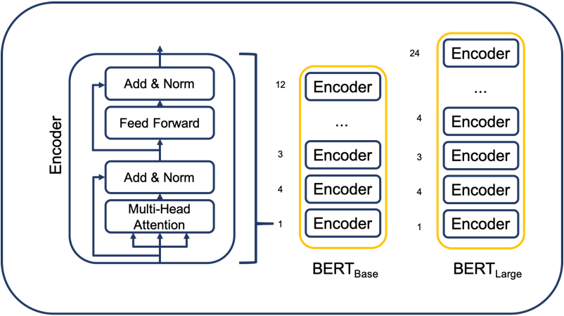
Further Improvements (BERT)
If given more time we would do the following:
Collect better data in consultation with experts
We attempted implementing tiny-BERT but could have tried larger models given more processing power
We could also explore hyper parameter tuning given more time

